Slide 1

ELECTORAL PROCESS MANAGEMENT
A project submitted in partial fulfilment of the requirements for BACHELOR IN INFORMATION TECHNOLOGY (BIT) 2ND SEMESTER Of Purbanchal University, Biratnagar, Nepal

Slide 2
TEAM MEMBERS
PRIYA KUSHWAHA
SAMIRA SHAHI

Slide 3
1
INTRODUCTION
CONTENTS
2
PROBLEM STATEMENT
3
OBJECTIVES
4
SCOPE & REQUIREMENT
5
ADVANTAGES
6
WATERFALL MODEL & USECASE DIAGRAM
7
SYSTEM FLOW & ER DIAGRAM
8
CONCLUSION

Slide 4


01
Introduction
WHAT IS ELECTORAL PROCESS MANAGEMENT?

Slide 5
Introduction
ONE
01
The “Electoral Process Management System” is a modern developed system to cast a vote. It depicts the development taking in the field of technology which are improving our lifestyles. This system includes all the processes that takes place in an actual voting process, like displaying all the competing parties and their respective representatives, also it contains a separate window for electoral manager which contains all the necessary details like number of votes casted, total number of votes gained by all parties, and hence the final result.

Slide 6

02
Problem Statement
WHAT IS THE PROBLEM WITH CURRENT ELECTORAL MANAGEMENT PROCESS?

Slide 7




02
CURRENT PROBLEMS
EXPENSIVE AND TIME CONSUMING
ERRORS DURING DATA ENTRY
TOO MUCH PAPER WORK
LOSS OF DATA DUE TO PAPER WORK

Slide 8

03
Objectives
WHAT DO WE PLAN TO ACHIEVE?

Slide 9



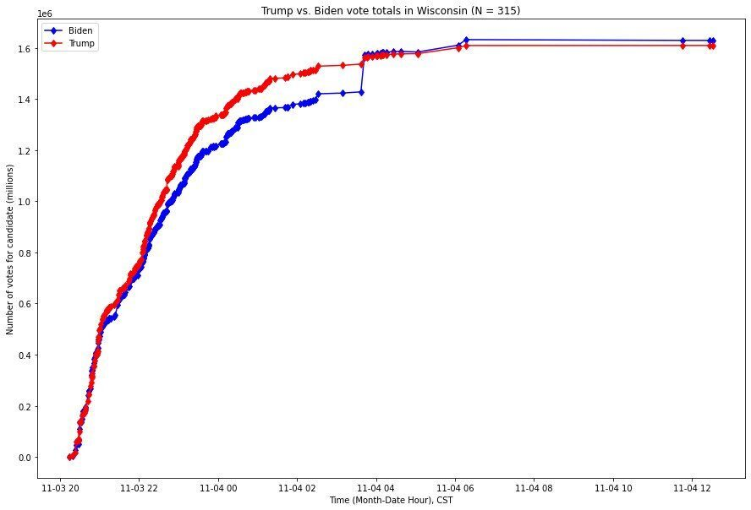
03
OBJECTIVES
TO REGISTER THE VOTERS DETAILS
TO CASTE THE VOTE
TO STORE THE VOTE COUNT
KNOW YOUR CANDIDATE

Slide 10

04
Scope
LETS SEE THE FUTURE SCOPE

Slide 11
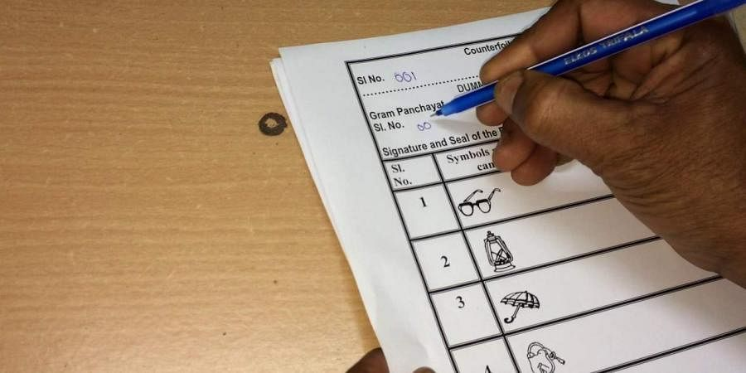



04
FUTURE ENHANCEMENT
THE DEMISE OF BALLOT PAPER
REMOTE SERVICE DELIVERY
THE RISE OF ELECTRONIC VOTING METHODS
ELECTRONIC IDENTITIES

Slide 12



04
Hardware Requirement
PC with Pentium II Processor
32 MB of RAM
Atleast Black and White Monitor
Hard disk with at least 20MB of free space
Software Requirement
OS Windows (Windows XP)
Applications: Dev C++ or other C++ compiler.

Slide 13

05
Advantages
ADVANTAGES OF THE SYSTEM

Slide 14



05
ADVANTAGES
FAST AND EASY WAY OF CONDUCTING ELECTION.
VOTERS CAN VIEW BACKGROUND OF EACH CANDIDATE
SYSTEM GENERATED UNIQUE ID AND PASSWORD GIVES MORE SECURE LOGIN
RESULT WILL BE OUT SOON.

Slide 15
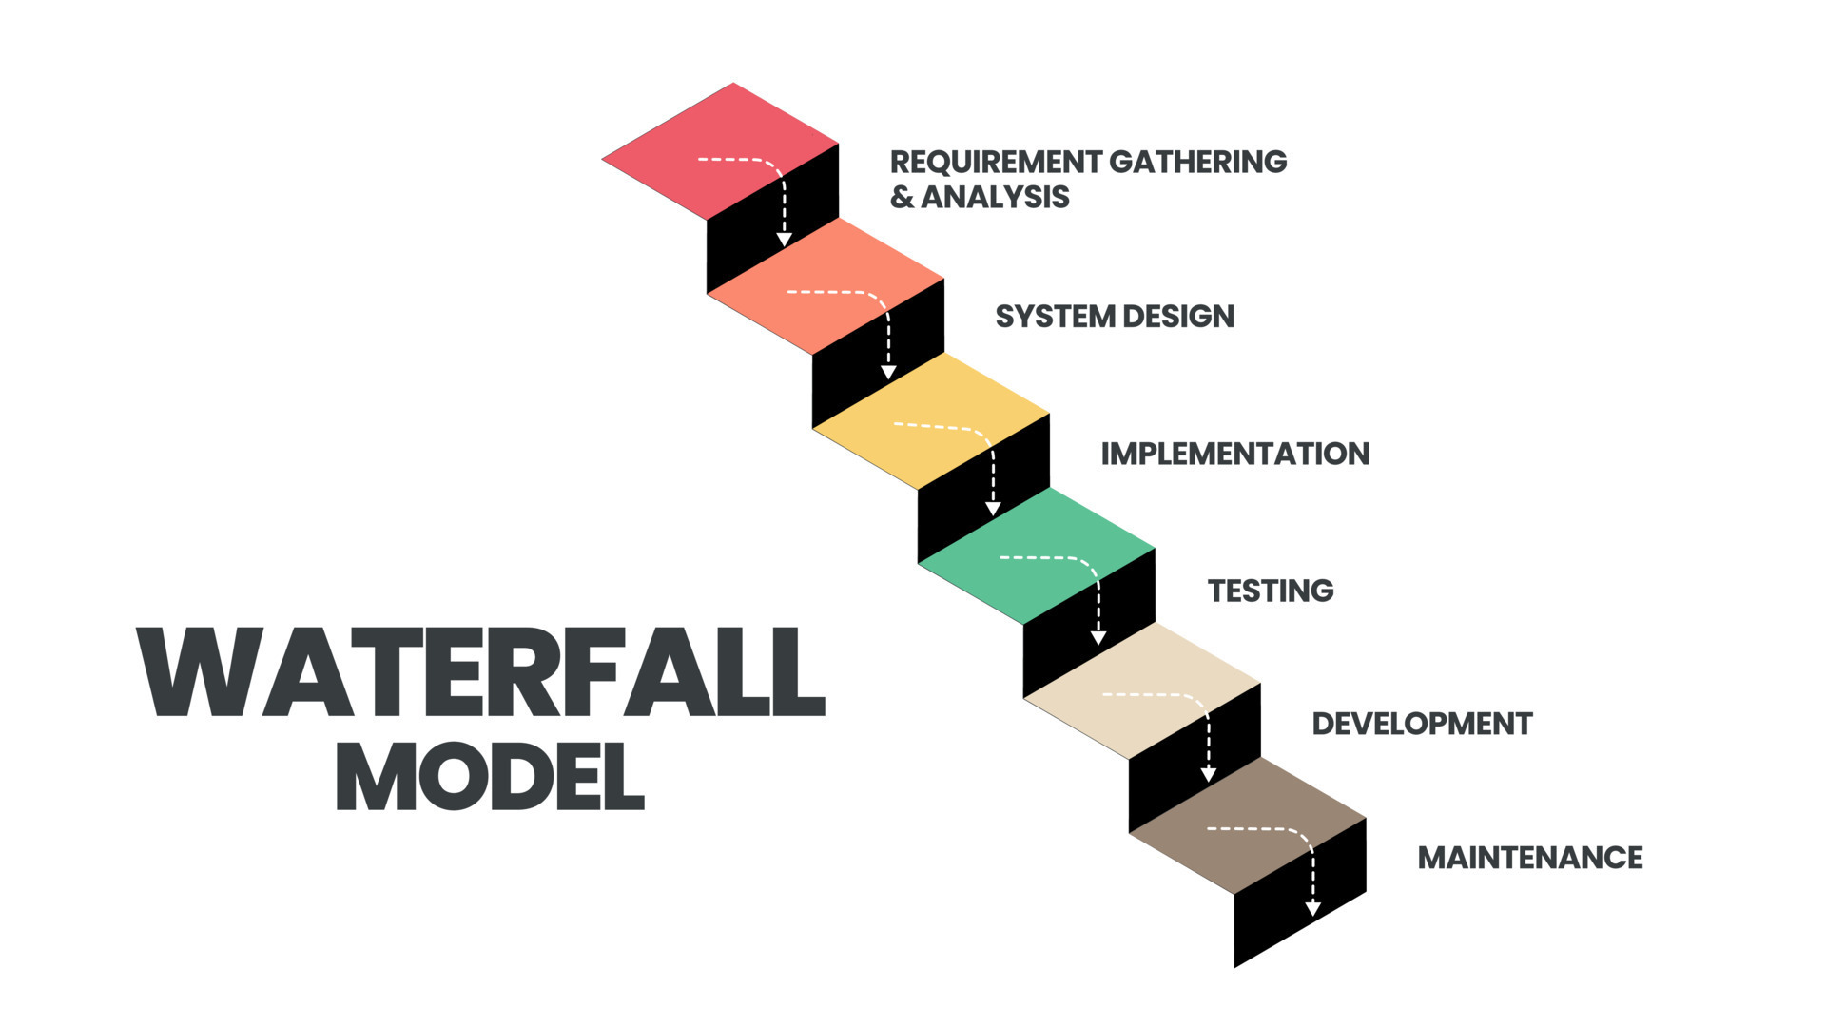
06
WATERFALL MODEL

Slide 16
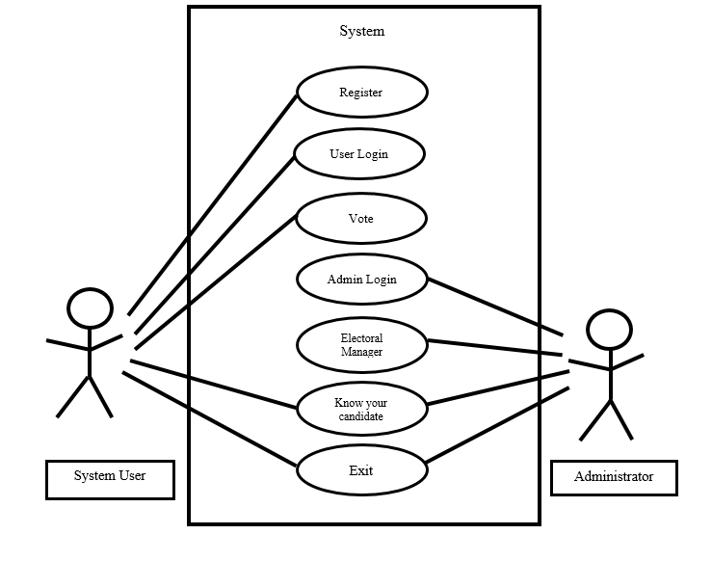
07
Use-case diagram

Slide 17
06
System flow
Start
Intro
Choice
False Input
Default
True Input
Case1
Case2
Case3
Case4
Case5
Register
Vote
Electoral Manager
Know Your Candidate
Exit
Stop

Slide 18
06
System flow
start
Enter?
No
Yes
Press1?
Yes
Register
Enter Details
Generate ID & Password
No
Press2?
Yes
Vote
Enter ID & Password
Choose Party
Displays Party leader
No
Press3?
Yes
Electoral Manager
Enter ID & Password
Vote Count
No
Press4?
Yes
Know Your Candidate
Choose Candidate
Displays Candidate Details
No
Stop

Slide 19
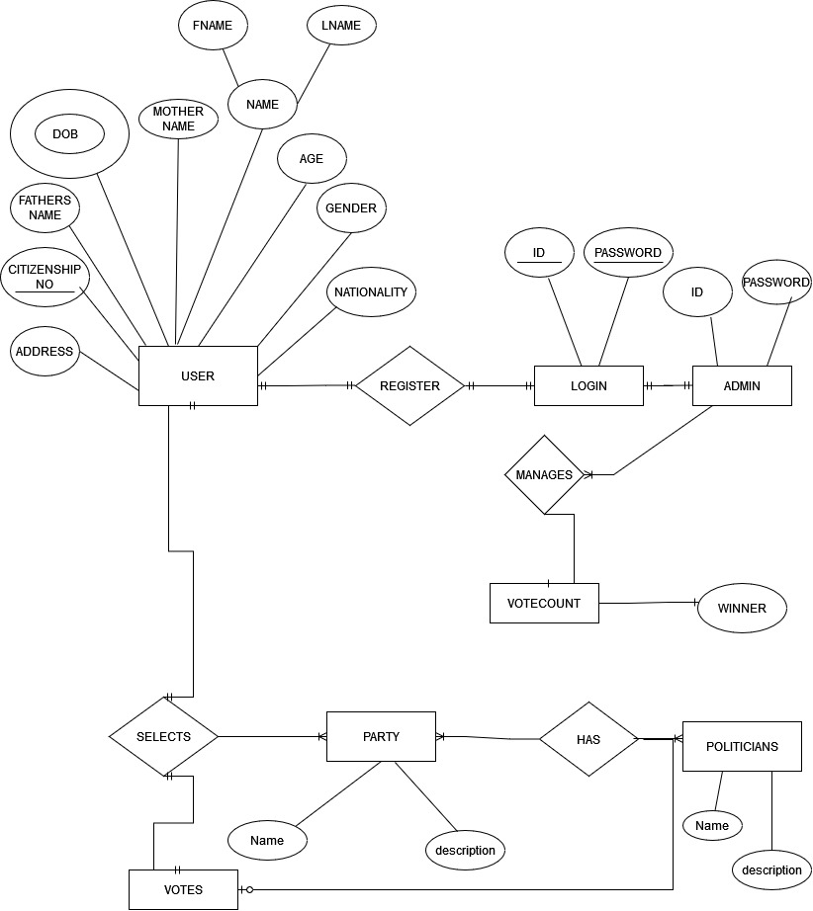
08
ER diagram

Slide 20
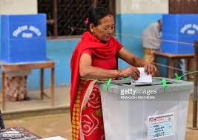
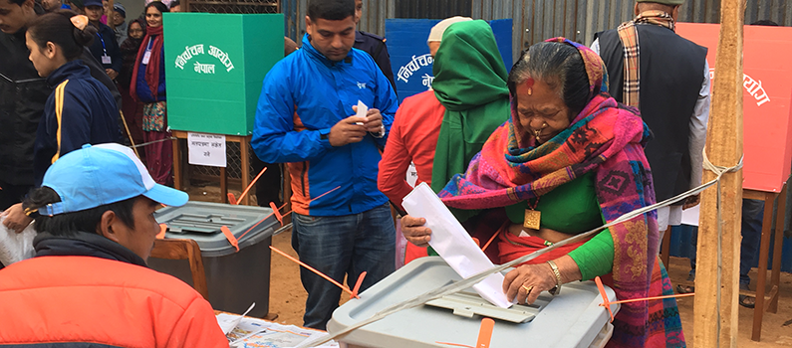

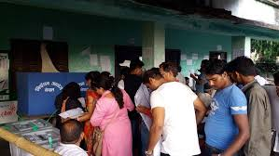
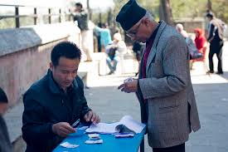

Slide 21

08
CONCLUSION
CONCLUDING………….

Slide 22
CONCLUSION
ONE
01
This software is efficient in casting the vote and counting the vote.
This software also reduces the burden voting day. in future, this system can be launched on websites for easy election.
AT LAST, WE WOULD LIKE TO EXTEND OUR GRATITUDE TO THE EXTERNALS AND ALL OUR FRIENDS WHO STOOD BY US DURING ENTIRE PRESENTATION.

Slide 23
Thankyou
FOR YOUR PATIENCE

